Slide 1
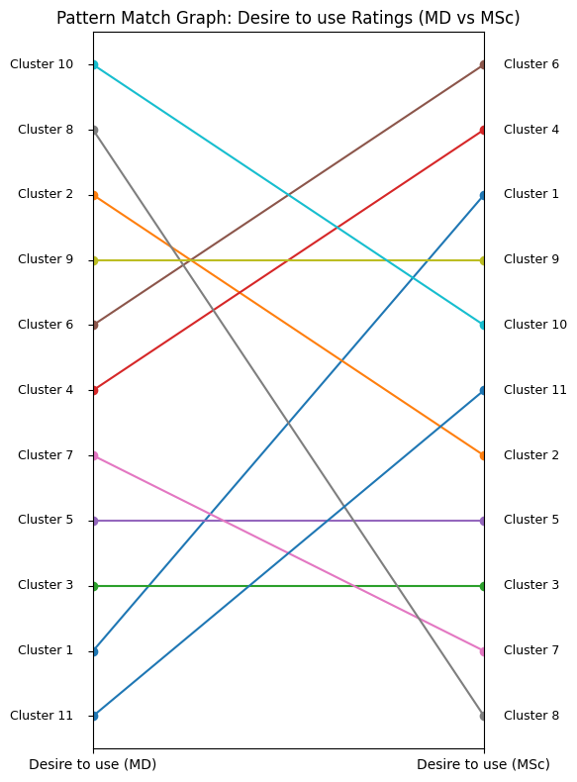
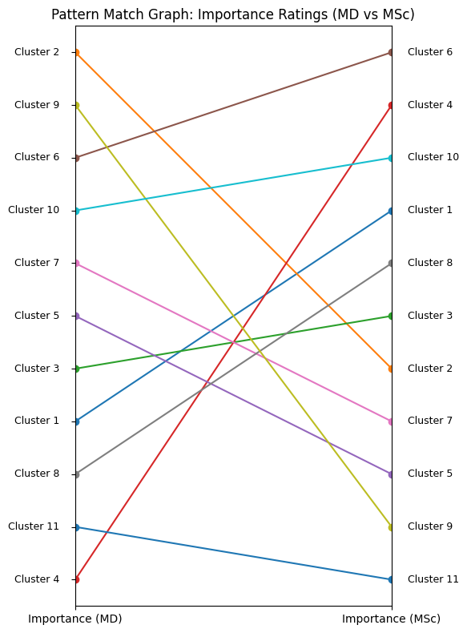
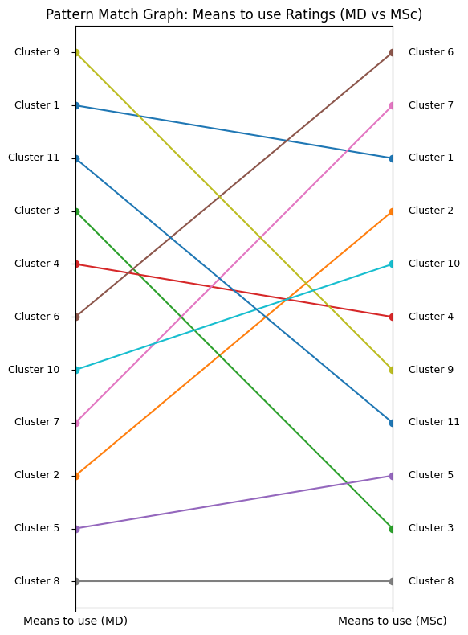
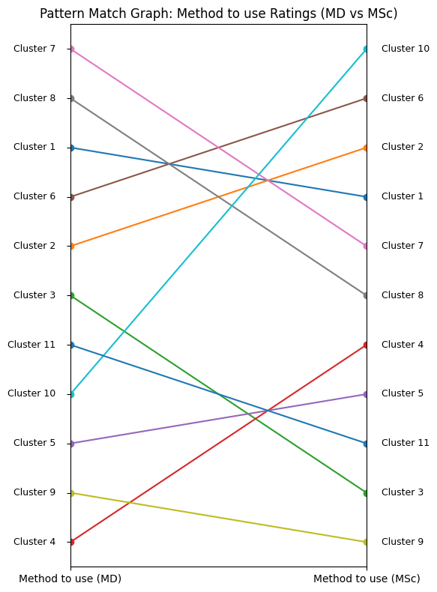
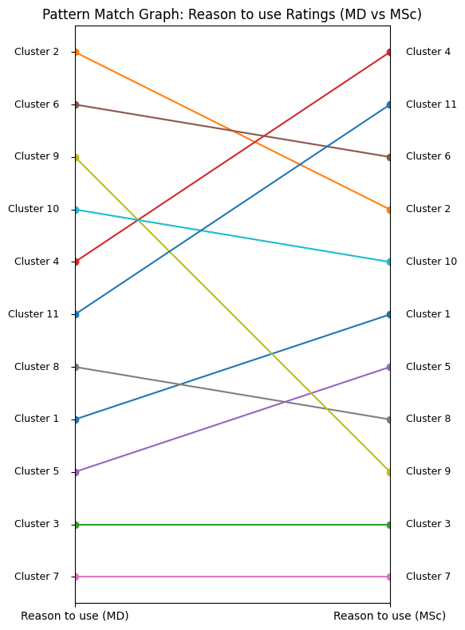
Desire to use Ratings (AI users vs AI developers)
Importance Ratings (AI users vs AI developers)
Means to use Ratings (AI users vs AI developers)
Method to use Ratings (AI users vs AI developers)
Reason to use Ratings (AI users vs AI developers)
C 10
C 6
C 2
C 6
C 9
C 6
C 7
C 10
C 2
C 4
C 8
C 4
C 9
C 4
C 1
C 7
C 8
C 6
C 6
C 11
C 2
C 1
C 6
C 10
C 11
C 1
C 1
C 2
C 9
C 6
C 9
C 9
C 10
C 1
C 3
C 2
C 6
C 1
C 10
C 2
C 6
C 10
C 7
C 8
C 4
C 10
C 2
C 7
C 4
C 10
C 4
C 11
C 5
C 3
C 6
C 4
C 3
C 8
C 11
C 1
C 7
C 2
C 3
C 2
C 10
C 9
C 11
C 4
C 8
C 5
C 5
C 5
C 1
C 7
C 7
C 11
C 10
C 5
C 1
C 8
C 3
C 3
C 8
C 5
C 2
C 5
C 5
C 11
C 5
C 9
C 1
C 7
C 11
C 9
C 5
C 3
C 9
C 3
C 3
C 3
C 11
C 8
C 4
C 11
C 8
C 8
C 4
C 9
C 7
C 7
AI users
AI developers
AI users
AI developers
AI users
AI developers
AI users
AI developers
AI users
AI developers

Slide 2
Desire to use Ratings (AI users vs AI developers)
Importance Ratings (AI users vs AI developers)
Means to use Ratings (AI users vs AI developers)
Method to use Ratings (AI users vs AI developers)
Reason to use Ratings (AI users vs AI developers)
C 10
C 6
C 2
C 6
C 9
C 6
C 7
C 10
C 2
C 4
C 8
C 4
C 9
C 4
C 1
C 7
C 8
C 6
C 6
C 11
C 2
C 1
C 6
C 10
C 11
C 1
C 1
C 2
C 9
C 6
C 9
C 9
C 10
C 1
C 3
C 2
C 6
C 1
C 10
C 2
C 6
C 10
C 7
C 8
C 4
C 10
C 2
C 7
C 4
C 10
C 4
C 11
C 5
C 3
C 6
C 4
C 3
C 8
C 11
C 1
C 7
C 2
C 3
C 2
C 10
C 9
C 11
C 4
C 8
C 5
C 5
C 5
C 1
C 7
C 7
C 11
C 10
C 5
C 1
C 8
C 3
C 3
C 8
C 5
C 2
C 5
C 5
C 11
C 5
C 9
C 1
C 7
C 11
C 9
C 5
C 3
C 9
C 3
C 3
C 3
C 11
C 8
C 4
C 11
C 8
C 8
C 4
C 9
C 7
C 7
AI users
AI developers
AI users
AI developers
AI users
AI developers
AI users
AI developers
AI users
AI developers

